Slide 1
Uninformed Search
CS161
Prof. Guy Van den Broeck

Slide 2
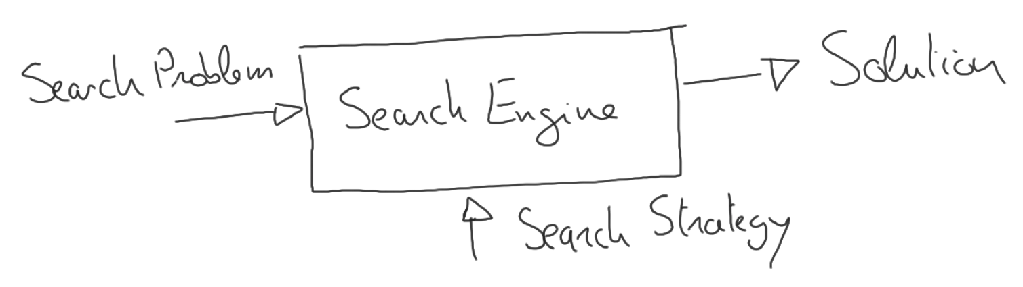

What is uninformed search?
Construct a search tree of the state space
Two important notions:
Expanding a state
Generating a state
Fringe/frontier: nodes generated but not yet expanded
Essence of search: which state to expand next?
Leads to different search strategies
Blind/uninformed vs. Heuristic/informed search

Slide 3
Tree Search Algorithm
frontier = {initial state}
loop do
if frontier is empty return fail
node = choose leaf to remove from frontier
if node is goal state return node’s state
frontier += expand(node)

Slide 4
Graph Search Algorithm
frontier = {initial state}
loop do
if frontier is empty return fail
node = choose leaf to remove from frontier
if node is goal state return node’s state
frontier += expand(node)
+ Add chosen leaf to explored set (initially empty)
+ Add only new nodes to frontier
Nodes not in frontier or explored set

Slide 5
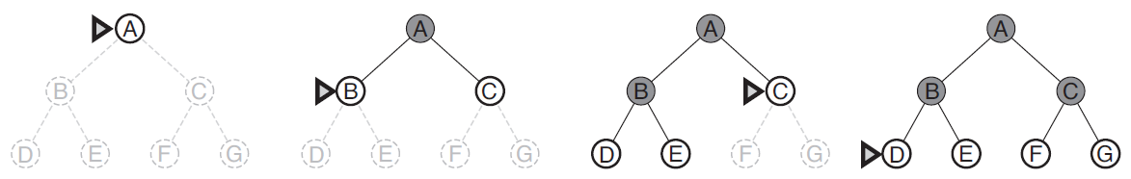
Breadth-First Search

Slide 6
Properties
Complete?
Optimal?
Time complexity?
Space complexity?

Slide 7
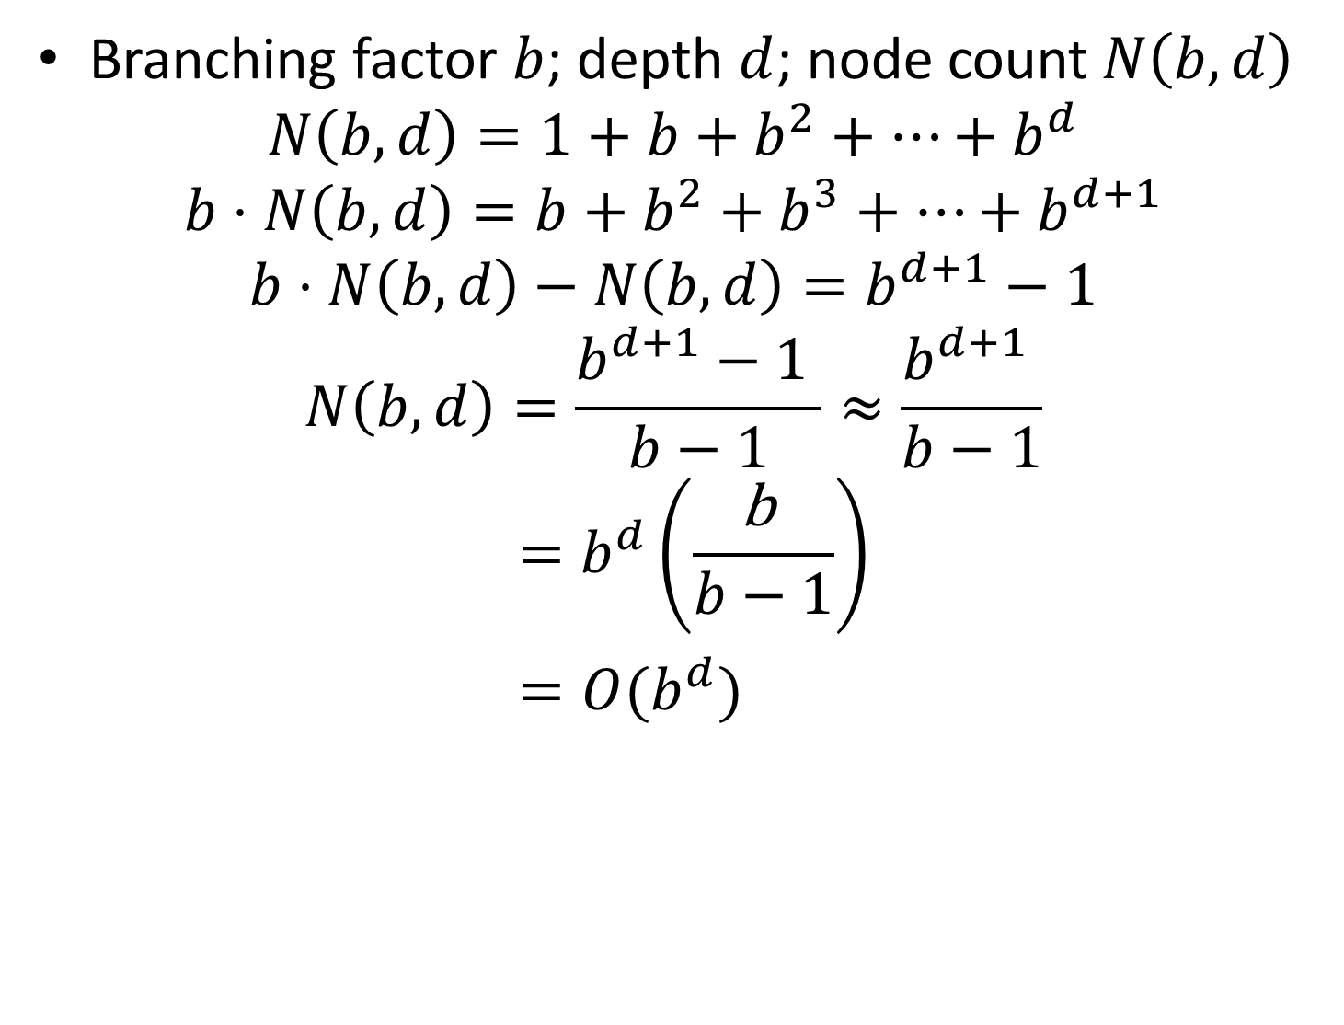
How Many Nodes in Search Tree?
∈

Slide 8
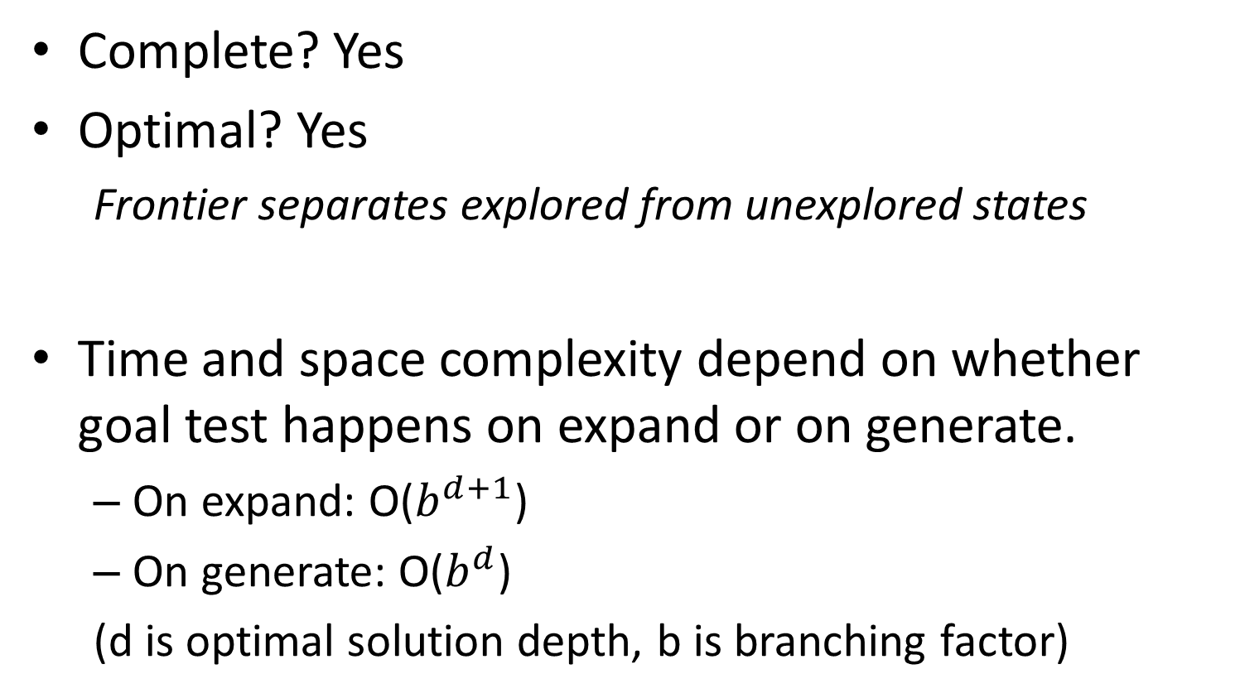
Properties

Slide 9
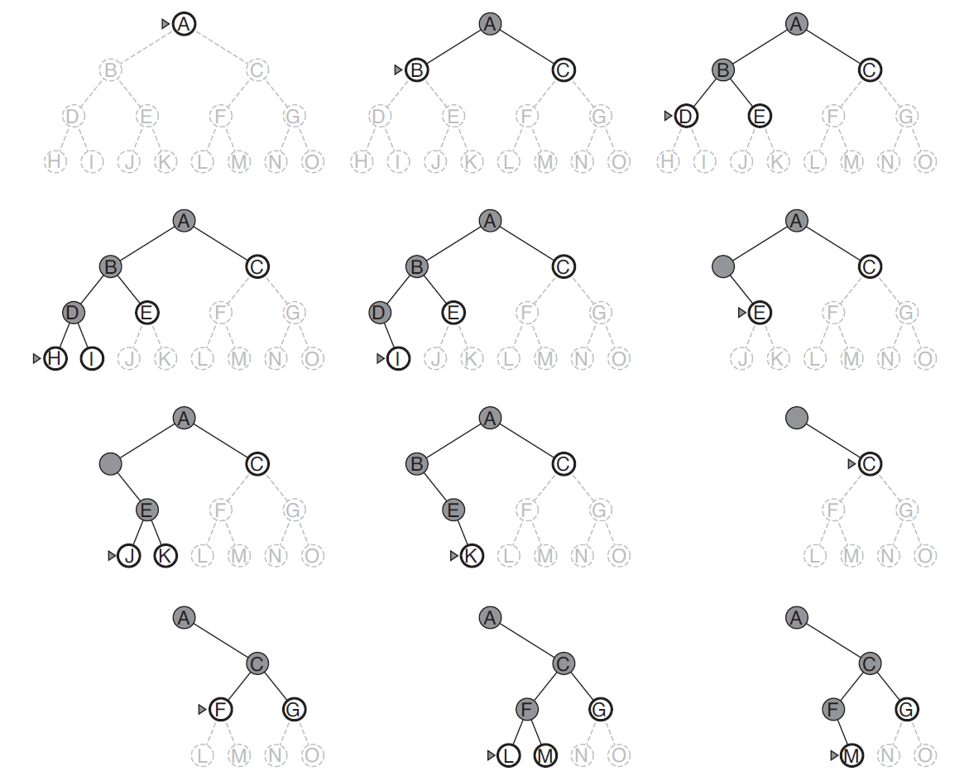
Depth-First Search

Slide 10
Properties
Complete?
Optimal?
Time complexity?
Space complexity?

Slide 11
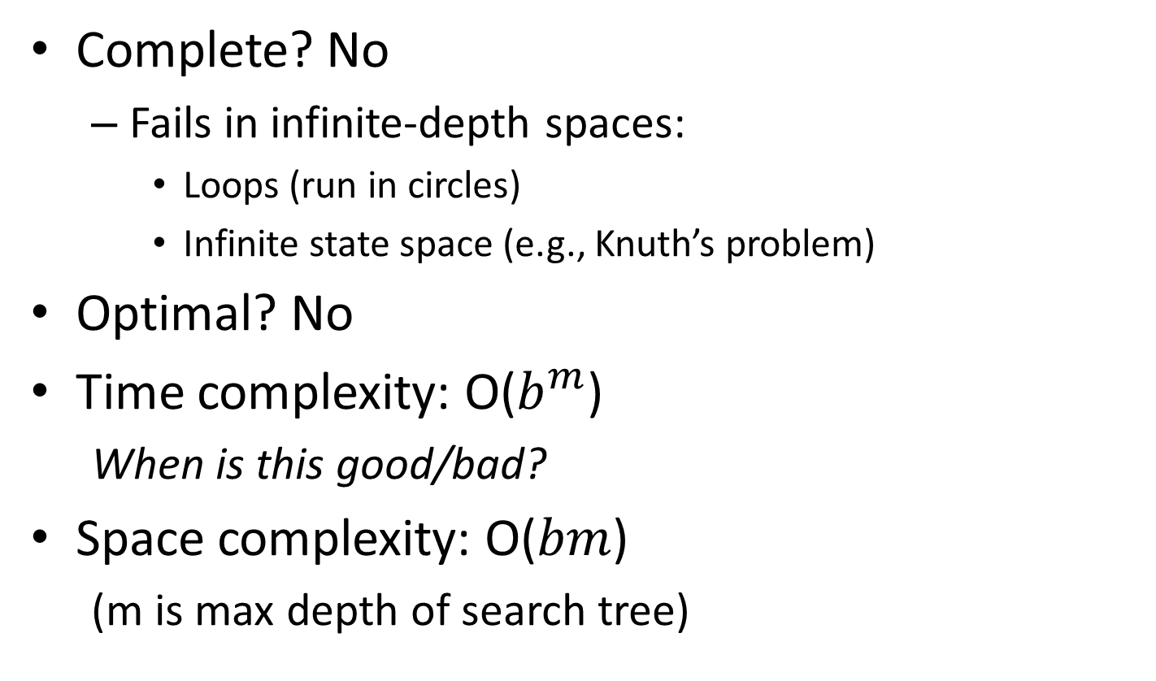
Properties

Slide 12
What about repeated states?
Can turn a linear problem into exponential
E.g.:
E.g.: moving in a grid
Search tree at depth d has O(4^d) nodes
Only O(d^2) distinct leaves (a circle in the grid)
For d=20: trillion vs. hundred nodes.
DFS is not for free!
A
A
B
C
D
E
B
B

Slide 13
How to deal with repeated states?
Check your parents
Check your ancestors
Check every node visited already
(1-2) is cheap with DFS
(3) is graph search instead of tree search
Complexity O(s) where s is number of states
Can be less than O(b^d) but more than O(bd)

Slide 14
Can we make DFS terminate?

Slide 15
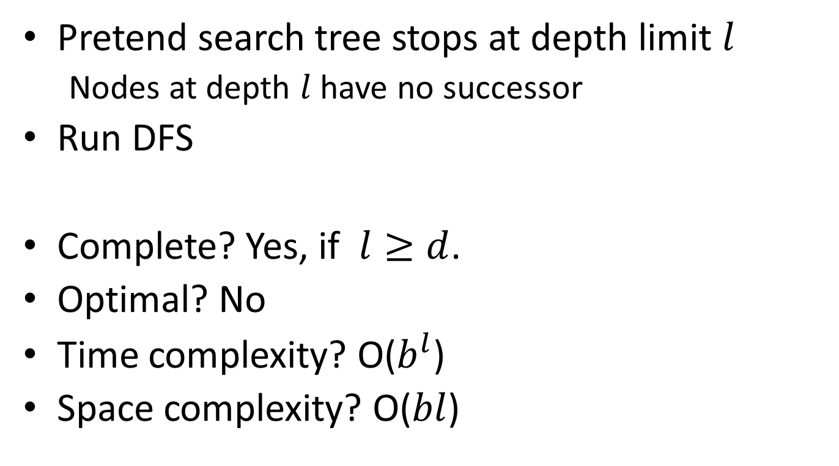
Depth-Limited Search

Slide 16
Properties
Complete?
Optimal?
Time complexity?
Space complexity?

Slide 17
Depth-Limited Search

Slide 18
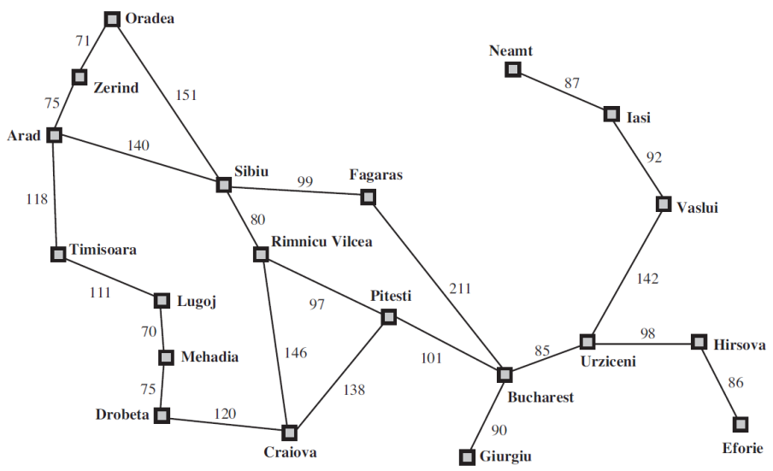
Can we make DLS complete?
How do we set depth limit l?
Maximum length path without repeated states
Compute the diameter of search space: Maximum shortest path between any two nodes
E.g., Romania has 20 cities:
Depth limit 19 is trivial
Diameter is 9, therefore depth limit 9
More general solution?

Slide 19
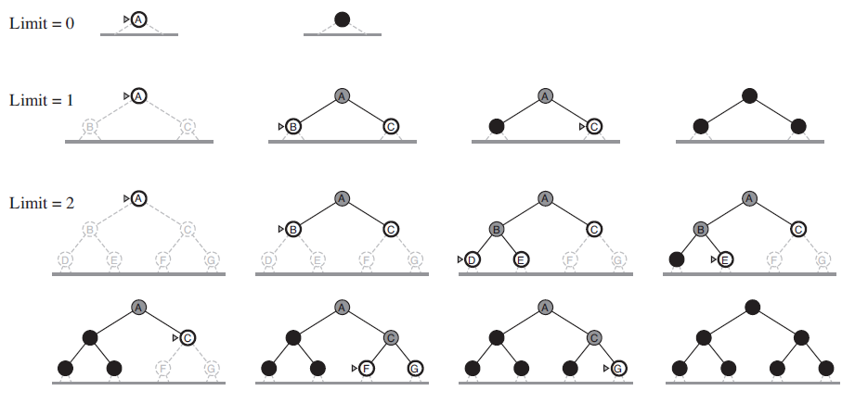
Iterative Deepening

Slide 20
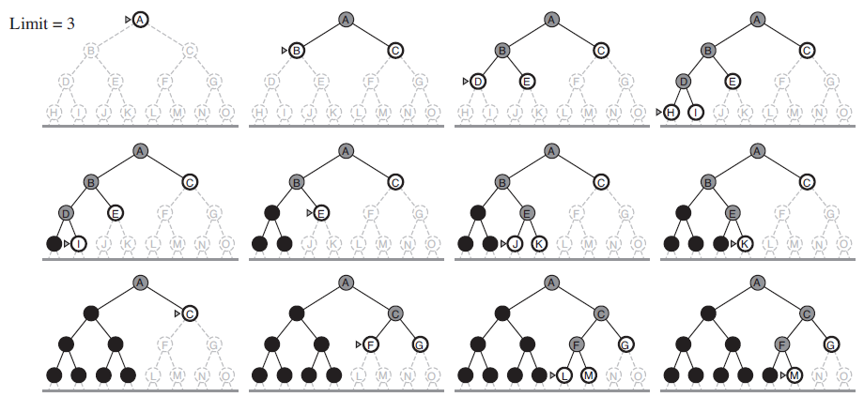
Iterative Deepening

Slide 21
Properties
Complete?
Optimal?
Time complexity?
Space complexity?

Slide 22
Properties
Complete? Yes
Optimal? Yes
Space complexity? O(bd)
Time complexity?

Slide 23
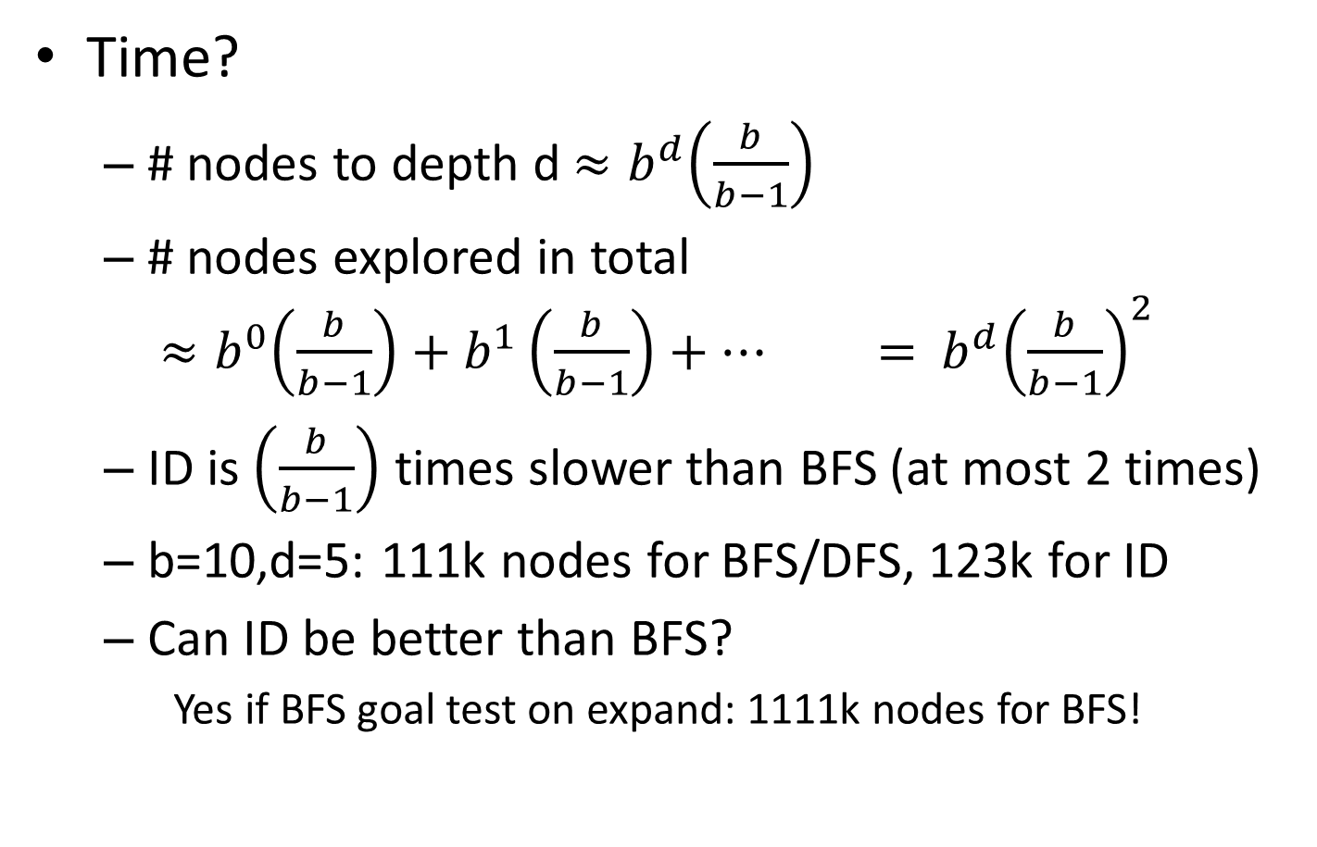
ID Time Complexity

Slide 24

Bidirectional Search

Slide 25
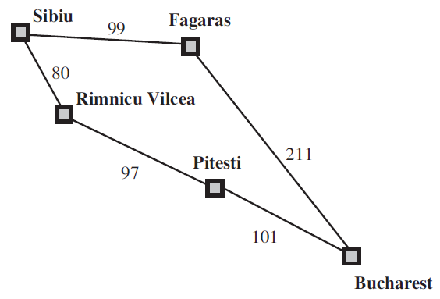
What if costs not 1 per action?

Slide 26
Uniform-Cost Search
f(n) is distance g(n) from start

Slide 27
Properties
Complete?
Optimal?
Time complexity?
Space complexity?

Slide 28
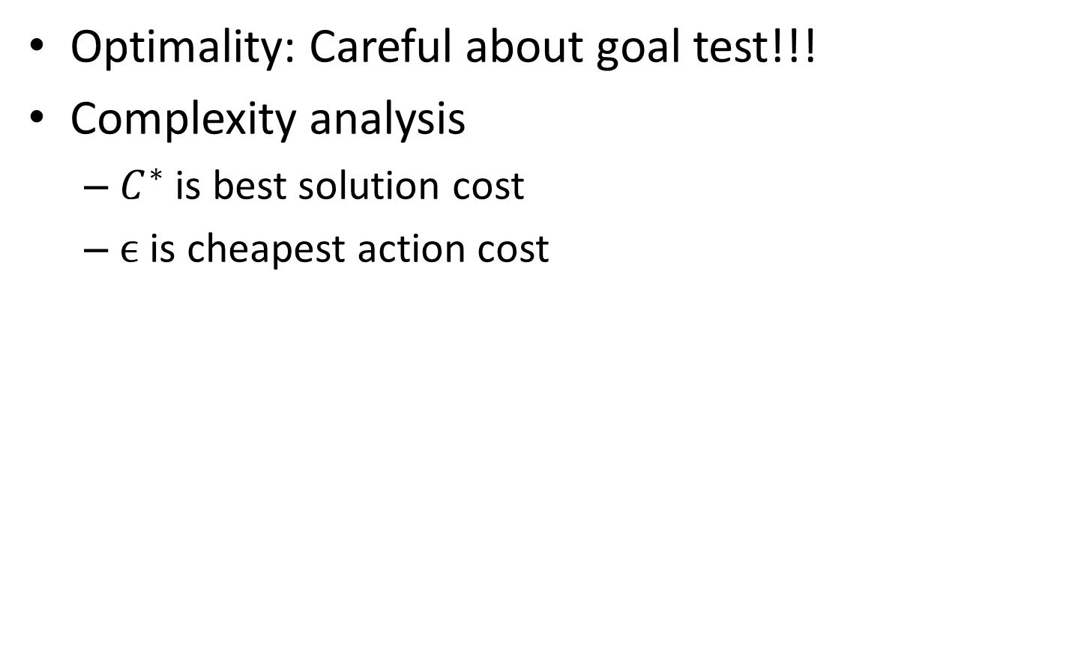
Properties

